Slide 1

Web Development - HTML + CSS
mintesnot

Slide 2

What is SharePoint Site Customization?

Slide 3

Web Development
Web development is the process of creating websites and web applications that run on the internet.
It involves designing, building , and maintaining webpages using different technologies.
Main Purpose of Web Development
🌐 Share information online 🛒 Build e-commerce websites 📚 Create educational platforms 💼 Develop business websites 📱 Create interactive web applications
Key Takeaway
HTML builds the structure, CSS adds beauty, and JavaScript adds intelligence.
HTML = Skeleton 🦴 CSS = Skin/Clothes 🎨 JavaScript = Brain 🧠

Slide 4
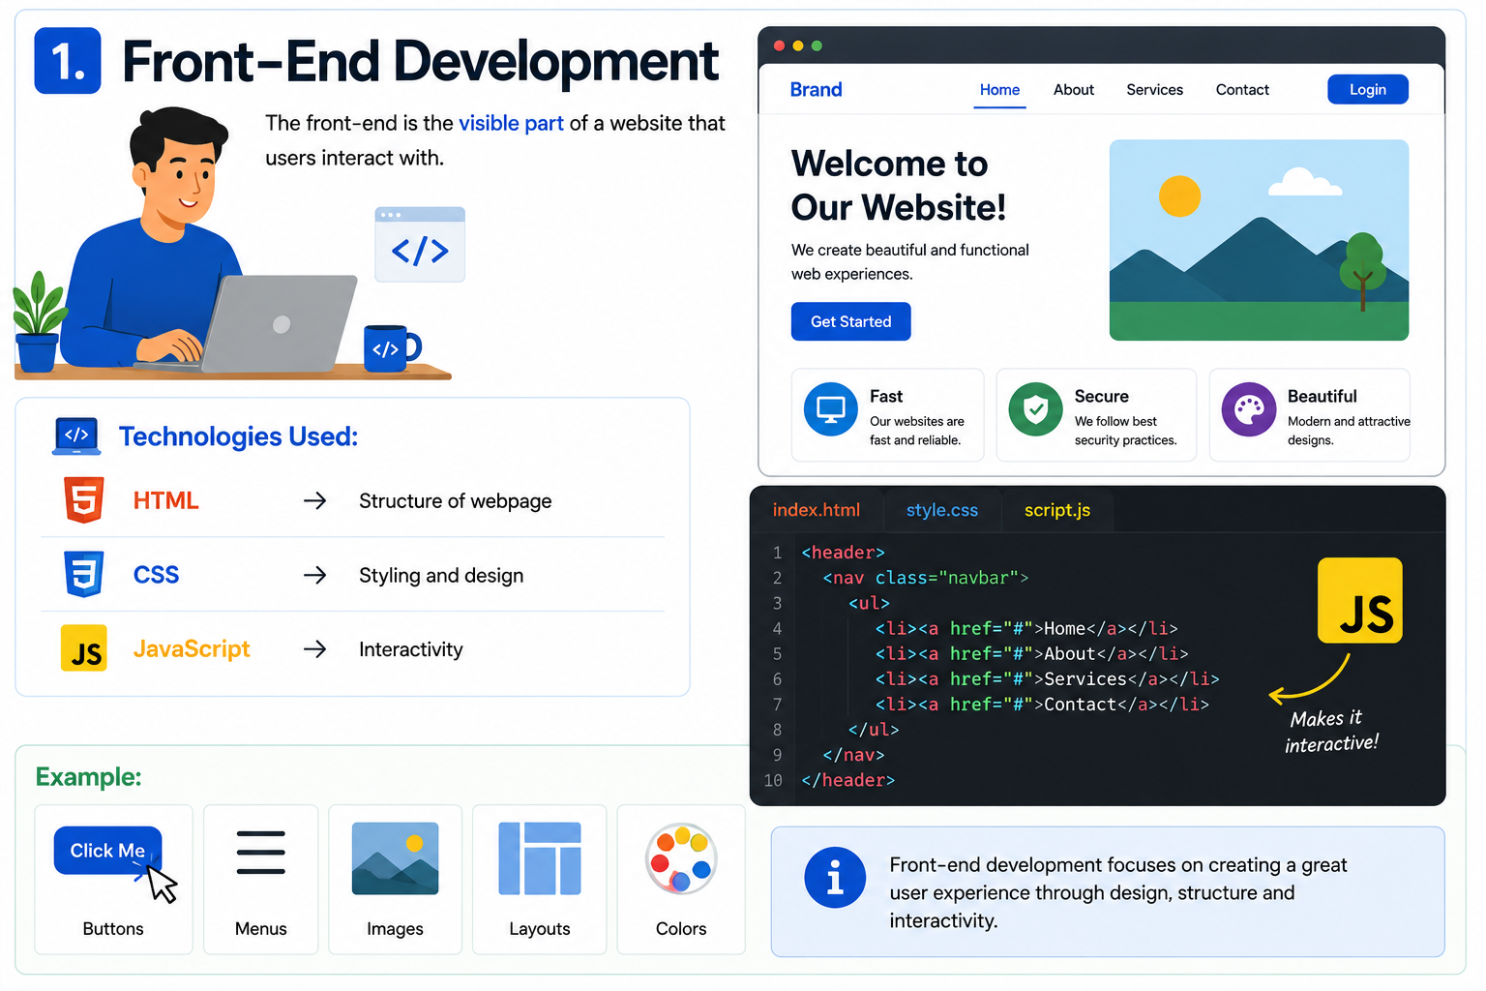
1. Front-End Development
The front-end is the visible part of a website that users interact with.
Technologies Used: ✅ HTML → Structure of webpage ✅ CSS → Styling and design ✅ JavaScript → Interactivity
Example:
Buttons
Menus
Images
Layouts
Colors

Slide 5
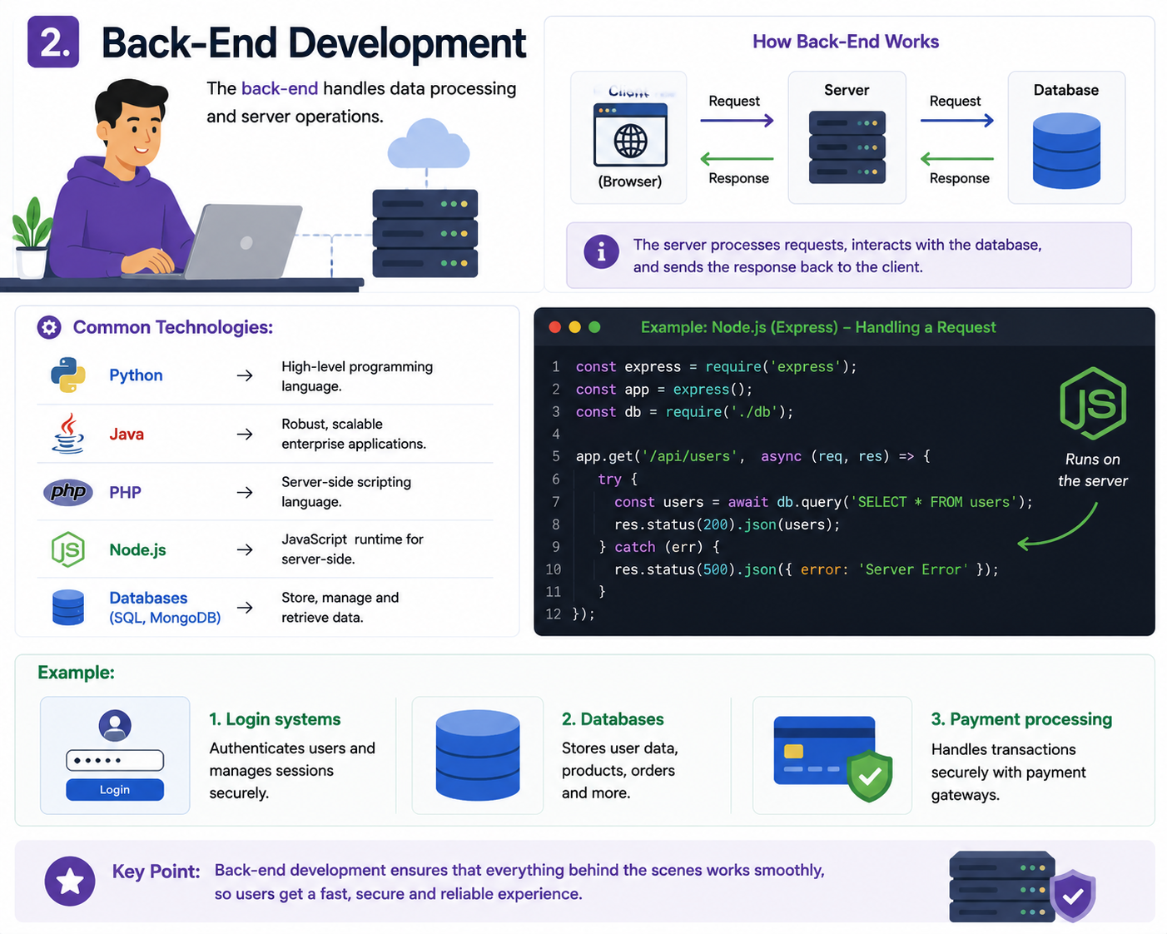
2. Back-End Development
The back-end handles data processing and server operations.
Common Technologies:
Python
Java
PHP
Node.js
Databases (SQL, MongoDB)
Example:
Login systems
Databases
Payment processing

Slide 6
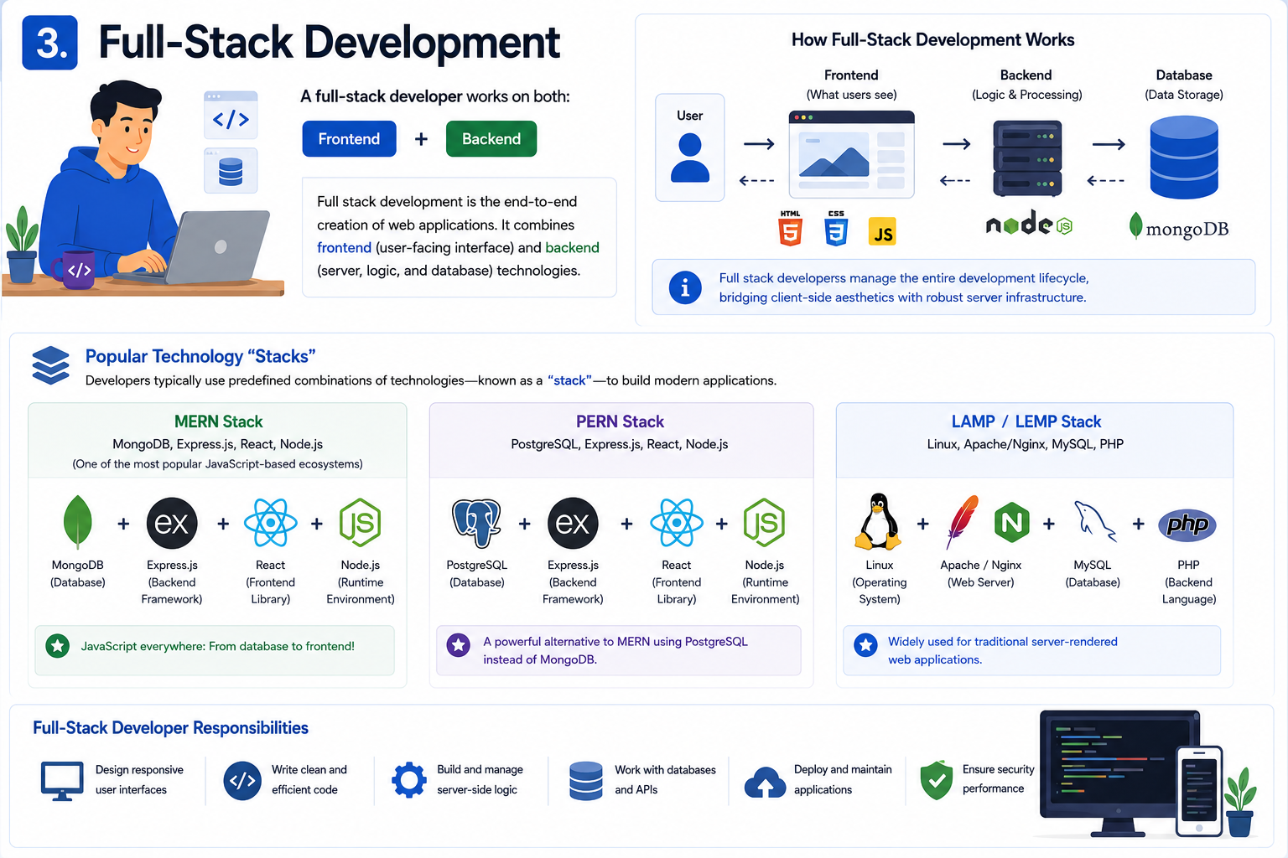
3. Full-Stack Development
The full-stack developer works on both: Frontend + Backend.
Developers typically use predefined combinations of technologies – known as “stack” – to build modern applications.
MERN Stack: MongoDB, Express.js, React, Node.js. (One of the most popular JavaScript-based ecosystems).
PERN Stack: PostgreSQL, Express.js, React, Node.js.
LAMP / LEMP Stack: Linux, Apache/Nginx, MySQL, PHP.

Slide 7
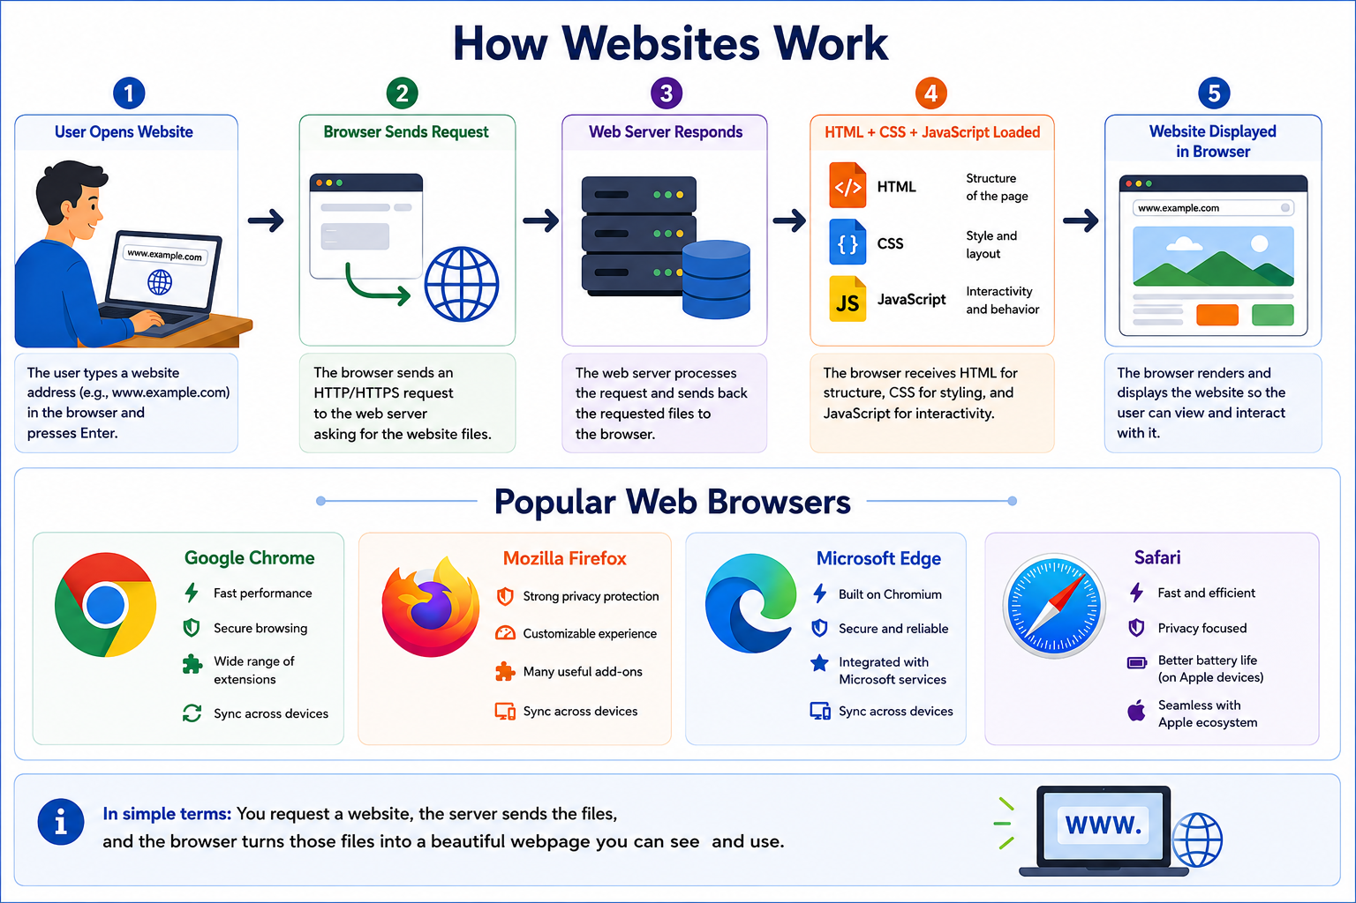

How Websites Work?
User Opens Website ⬇
Browser Sends Request ⬇
Web Server Responds ⬇
HTML + CSS + JavaScript Loaded ⬇
Website Displayed in Browser
Popular Web Browsers
Google Chrome
Mozilla Firefox
Microsoft Edge
Safari

Slide 8
What is HTML?
HTML stands for HyperText Markup Language.
It is the standard language used to create the structure of webpages.
HTML tells the browser:
✅ What content to display ✅ Where content should appear ✅ How webpage elements are organized
Without HTML, a webpage would have no structure.
Why Do We Use HTML?
HTML is used to:
📝 Add text to webpages 🖼️ Display images 🔗 Create links between pages 📋 Create tables and lists 📥 Build forms for user input 🎥 Add videos and multimedia

Slide 9
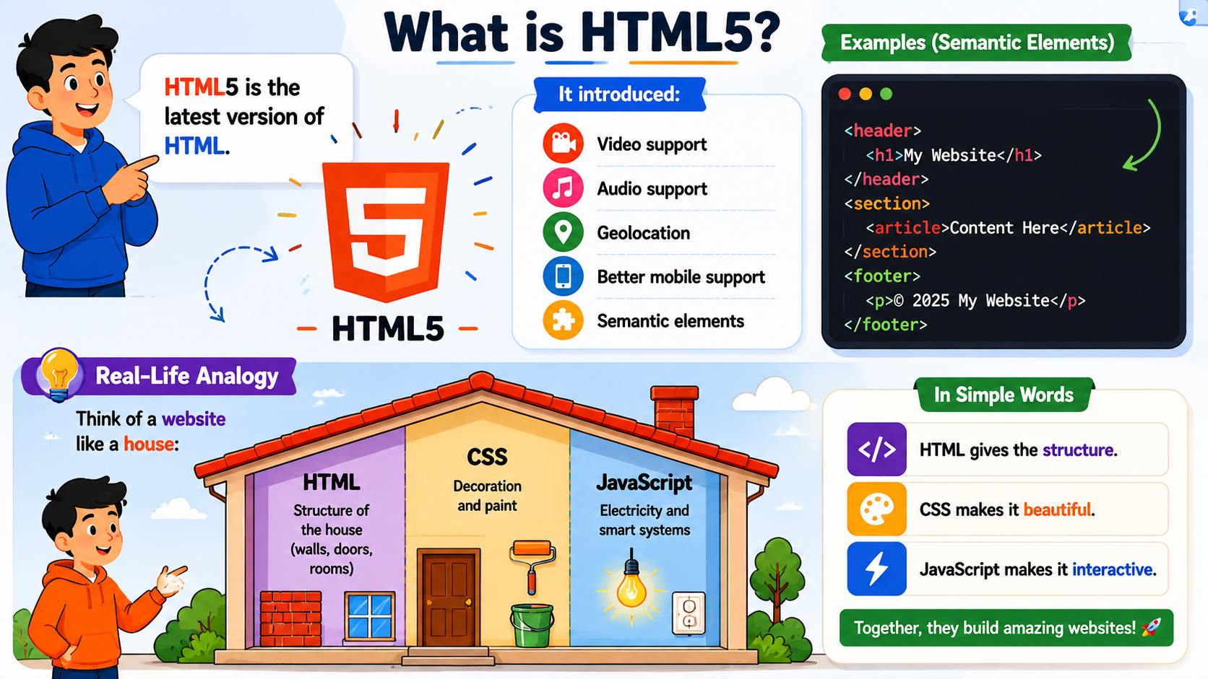

Features of HTML5
✅ Easy to learn ✅ Platform independent ✅ Supported by all browsers ✅ Works with CSS and JavaScript ✅ Used to create webpages
What is HTML5? - HTML5 is the latest version of HTML.
🎥 Video support 🎵 Audio support 📍 Geolocation 📱 Better mobile support 🧩 Semantic elements
Real-Life Analogy
Think of a website like a house:
🏠 HTML = Structure of the house (walls, doors, rooms) 🎨 CSS = Decoration and paint ⚡ JavaScript = Electricity and smart systems

